Slide 1
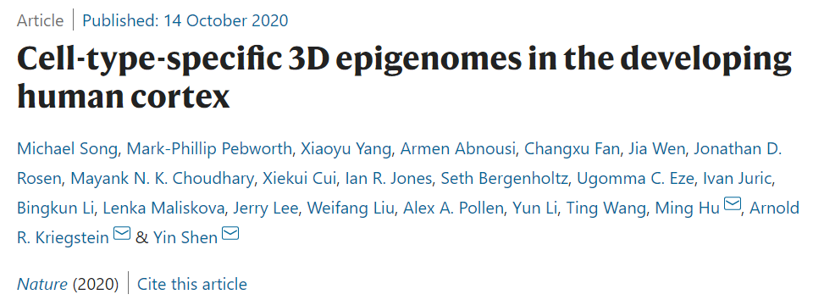
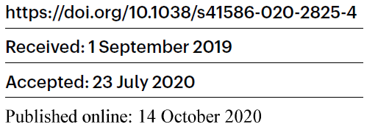
Siwei Zhang, 13 Nov 2020

Slide 2
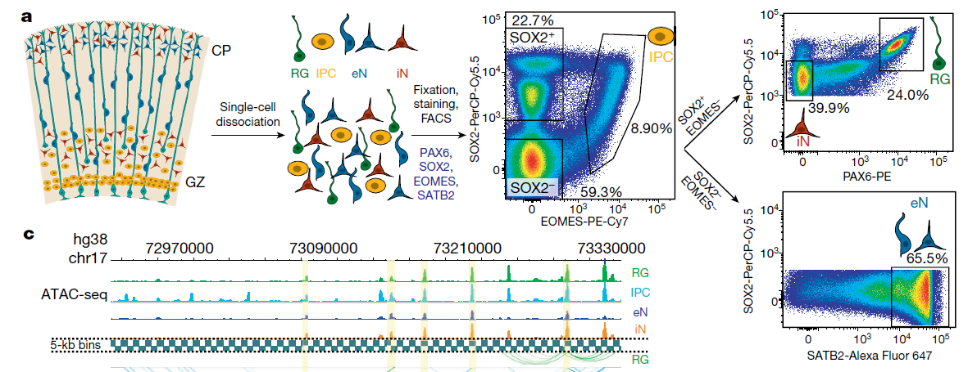
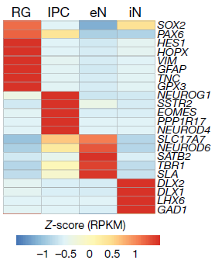
Dissociation and sorting cell types from the developing human cortex
Cortical
Plate
Germinal
Zone
IPC | SOX2+, EOMES (TBR2)+
RG | SOX2+, EOMES (TBR2)-, PAX6+
iN | SOX2+, EOMES (TBR2)-, PAX6-
eN | SOX2-, EOMES (TBR2)-, SATB2+

